Slide 1


Neural Network-based Hardware Implementation for Object Detection in Autonomous Driving
Supervised by:
Dr. Khaled Salah
Dr. Mohamed Desoukky
Done by:
1-Ramy Osama
2-Ahmed Yahia
3-Zyad Mahmoud
4-Rofida Osama
5-Omar Khaled

Slide 2
Agenda:
Introduction
Problem statement
Related work
Contribution
Methodology
Implementation
Future work

Slide 3
Introduction

Slide 4
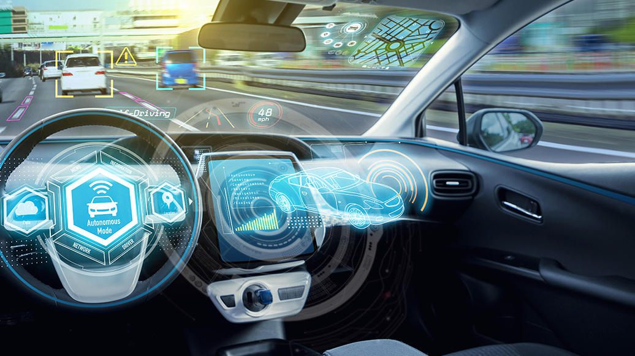
Introduction: Autonomous Car
Self-Driving car is a vehicle that is capable of sensing its environment and moving safely with little or no human input.
Accidents rate could be decreased by 90% after autonomous vehicles are in the streets.

Slide 5
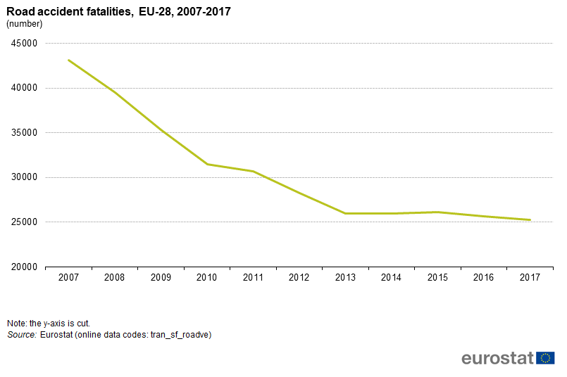

Slide 6
Introduction: Levels of automation.
Level 0 – No automation
Level 1 – Driver assistance
Level 2 – Partial automation
Level 3 – Conditional automation
Level 4 – High automation
Level 5 – Full automation

Slide 7
Introduction: Autonomous Vehicle System.
Autonomous Vehicle Software
Perception
Planning
Control
Autonomous Vehicle Hardware
Cameras
Lidar
Radar
Sensors

Slide 8
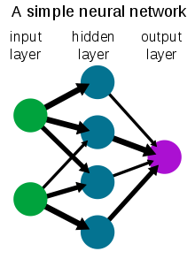
Introduction: Neural Networks
A neural network is a network or circuit of neurons, or in a modern sense, an artificial neural network, composed of artificial neurons or nodes. Thus, a neural network is either a biological neural network, made up of real biological neurons, or an artificial neural network, for solving artificial intelligence (AI) problems.

Slide 9
Problem statement

Slide 10
Why do we need neural networks in the project?
We will use a dataset of common objects we see normally in our daily life in streets to train our neural network to be able to recognise these objects in any future image that would be our input to the neural network.
Examples:
Cars
Human bodies
Cats
Dogs
Buses
Traffic posts

Slide 11
Related work

Slide 12
Going deeper with embedded fpga platform for convolutional neural network
In this paper, They go deeper with the embedded FPGA platform on accelerating CNNs and proposing a CNN accelerator design on embedded FPGA for Image-Net large-scale image classification using VGG-16 model
TensorFlow-object-detection-faster-rcnn // Shaoqing Ren, PY-faster-rcnn )2015
We got the software code using TensorFlow for the faster rcnn architecture
Edge boxes: Locating object ´ proposals from edges
The use of object proposals is an effective recent approach for increasing the computational efficiency of object detection. We figured out the method for generating object bounding box proposals using edges

Slide 13
A Platform based on HLS to Implement a Generic CNN on an FPGA,
In this paper ,it elaborates the advances of Field Programmable Gate Arrays tools allowing designs based on High-Level Synthesis, allowing a faster and an easier implementation on hardware of solutions for complex problems.This platform, developed in C language and synthetized through High-Level Synthesis, is prepared to configure a floating-point convolution neural network as a “lego”
Very Deep Convolutional Networks for Large-Scale Image
In this paper we investigate the effect of the convolutional network depth on its accuracy in the large-scale image recognition setting
https://github.com/1297rohit/VGG16-In-Keras. Coding for the vgg16 layers in keras

Slide 14
An FPGA-based accelerator implementation for deep convolutional neural networks
In this paper, an optimized FPGA-based accelerator design has been proposed claiming best performance compared with existing implementations using the same Vivado HLS tool
Implementation of deep neural networks on FPGA-CPU platform using Xilinx SDSOC
In this paper, it introduces HW/SW partitioning which will enhance time design based on high level language(C or C++) in Vivado HLS (High Level Synthesis). It also fits for more large designs than using FPGA only and faster in design time.
16-ImageNet Classification with Deep Convolutional Neural Networks
In this paper, They trained a large, deep convolutional neural network to classify the 1.2 million high-resolution images in the ImageNet

Slide 15
Contribution

Slide 16
Phases of The Project.
1st phase is to find a suitable architecture of a neural network that would be able to satisfy our constrains (delay, complexity, etc..) and implement this architecture using python machine learning modules like TensorFlow and PyTorch.
2nd phase after simulating our neural network we will get the weights resulted from the simulation (more details on that later) and use it to implement a hardware chip on a FPGA development kit.
We finished the theory needed in the project and we made a small model for a neural network to detect some objects.
We will finish the Faster RCNN architecture and the hardware and its verification next semester as hardware is faster and can be reconfigured.

Slide 17
Methodology

Slide 18
Methodology:
Background
How it works
Comparative study
Challenges
Dataset

Slide 19
Methodology:
Background

Slide 20
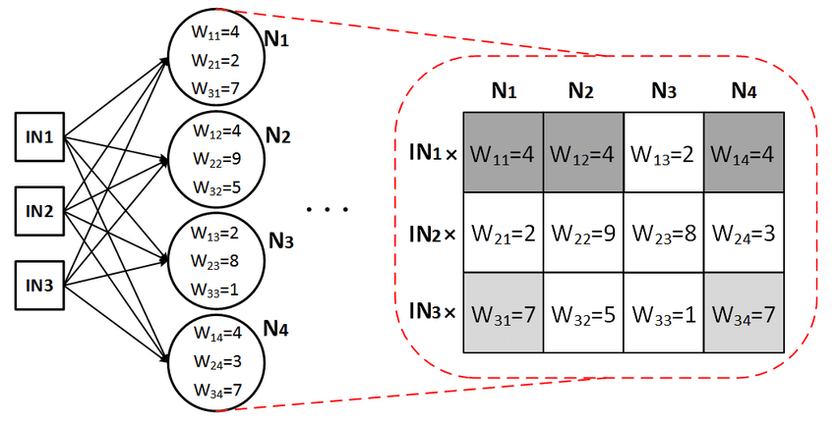
How a neuron operates ?
A neuron is just a mathematical function that takes inputs and returns outputs.

Slide 21
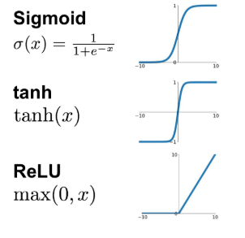
Types of activation functions.
An activation function improves the learning power of the neural network by applying some non-linearity.
Most common types include : sigmoid , RELU, and hyperbolic tangent function.
Problem of sigmoid and hyperbolic tangent function is the vanishing gradient for large input values.
RELU is commonly used as it is six times faster than sigmoid, also no gradient problem.

Slide 22
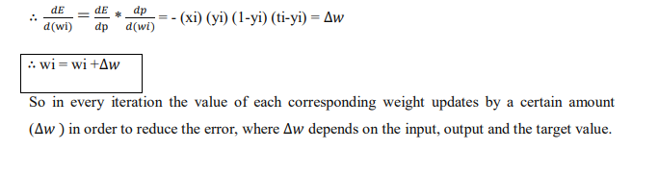
How to update the weights ?
This is usually done by an algorithm known as the backpropagation algorithm.
It is simply a feedback in which the target value , the inputs to the neural network and the outputs from the neural networks are used to update the value of each corresponding weight.
The main target is Minimizing the mean squared error and approach the correct target value.

Slide 23
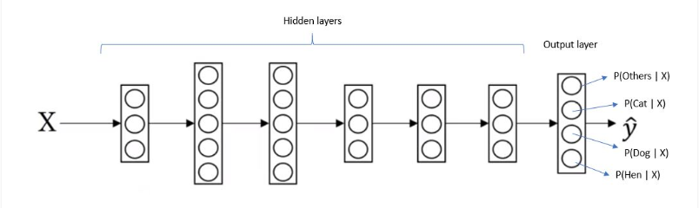
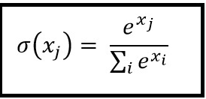
The SoftMax function.
The SoftMax function is used at the final output layer.
The main purpose is mapping the information to a probability distribution.

Slide 24
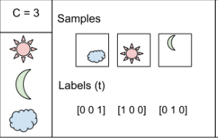
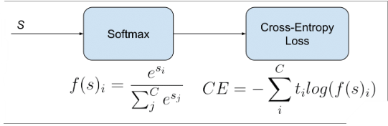
Loss functions and their types.
Loss function helps in optimizing the parameters of the neural networks. Our objective is to minimize the loss for a neural network by optimizing its parameters (weights), very important in training our neural network.
Types include : binary cross entropy and categorical cross entropy.
E.g. the SoftMax output is [0.2,0.2,0.6].

Slide 25
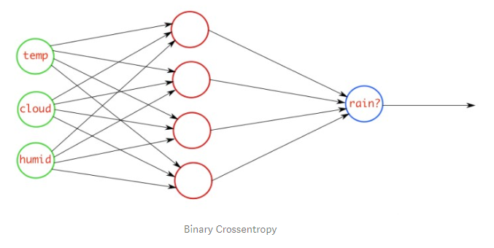
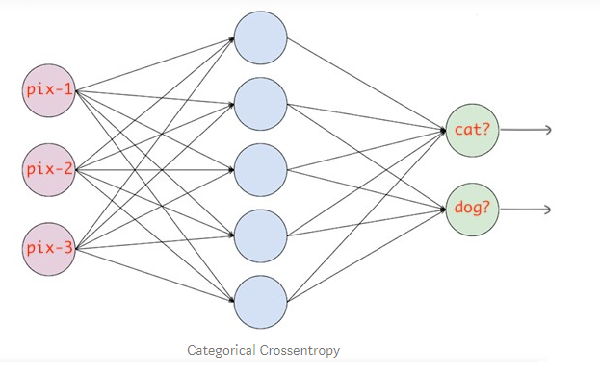
Comparison between two types of loss functions.
Categorical cross entropy.
Binary cross entropy.

Slide 26
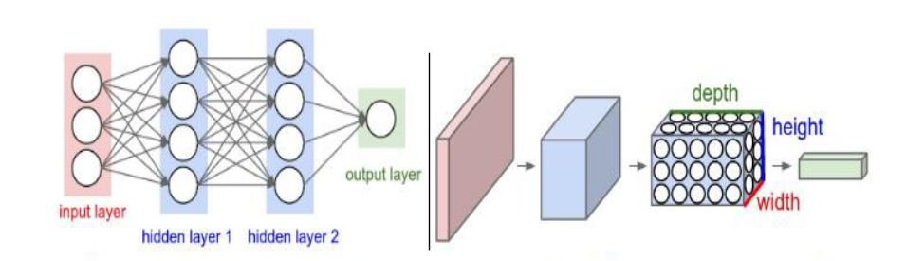
What is CNN and why using it?
Very similar to ordinary Neural Networks they are made up of neurons that have learnable weights and biases.
Take advantage of the fact that the input consists of images and constrain the architecture in a more sensible way.

Slide 27
Layers of CNN.
Convolution
Pooling
Fully connected

Slide 28
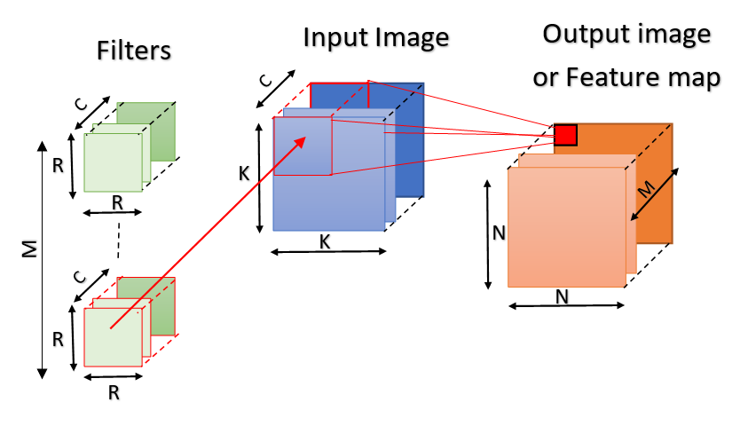
Convolution layer.
To extract the features
Different filters which detect different features are convolved on the input file and a set of activation maps is outputted and passed to the next layer.
three hyperparameters : depth ,Stride and Zero padding.

Slide 29
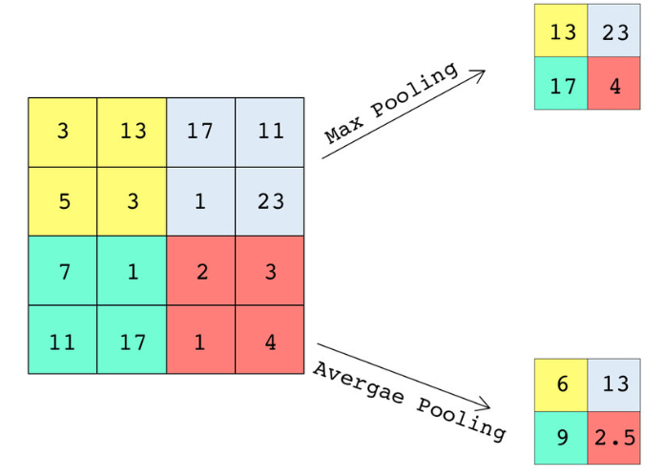
Pooling layer.
For reducing the spatial size of the representation (down-sampling)
Two types including : max pool and average pool.
Important parameters include: window size and the stride.

Slide 30

Max Pooling.
It is a pooling operation that calculates the maximum value in each patch of each feature map.
Max pooling is more commonly used than the average pooling.
This has been found to work better in practice than average pooling for computer vision tasks like image classification.

Slide 31
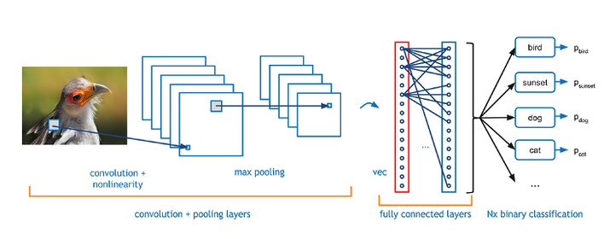
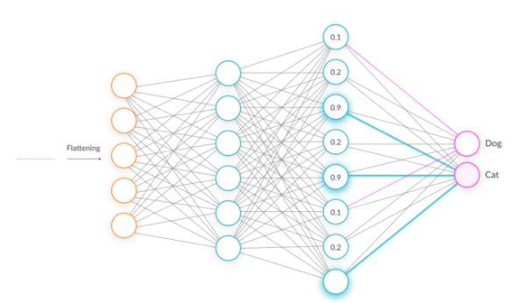
Fully connected layer.
Fully connected input layer (flatten)━takes the output of the previous layers, “flattens” them and turns them into a single vector that can be an input for the next stage
Connect all neurons from the previous layer to the next layer and use a SoftMax activation function to classify the number on the input image.

Slide 32
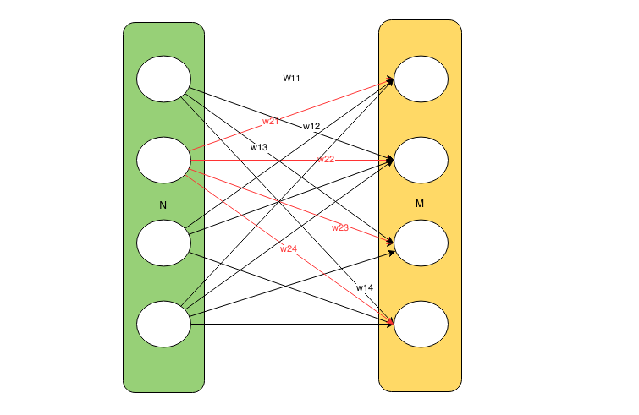
Fully connected layer takes the output of the previous layers, “flattens” them and turns them into a single vector that can be an input for the next stage
Output=(Flattened Input * Weights (2d array) ) + Bias

Slide 33
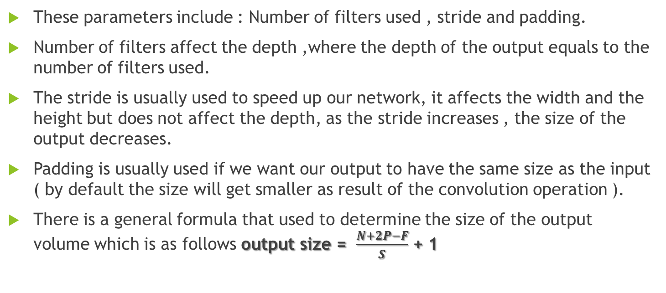
Parameters that affect the Output volume size in a CNN.
These parameters include : Number of filters used , stride and padding.
Number of filters affect the depth ,where the depth of the output equals to the number of filters used.
The stride is usually used to speed up our network, it affects the width and the height but does not affect the depth, as the stride increases , the size of the output decreases.
Padding is usually used if we want our output to have the same size as the input ( by default the size will get smaller as result of the convolution operation ).
There is a general formula that used to determine the size of the output volume which is as follows output size = $\frac{N+2P−F}{S}$ + 1

Slide 34
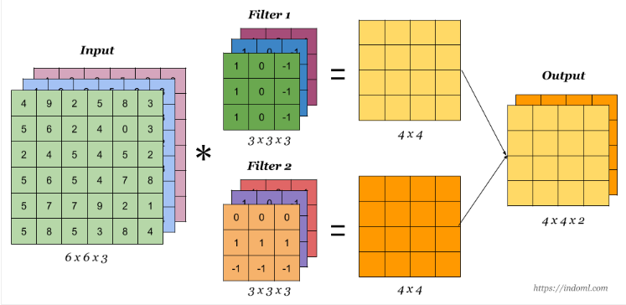
Effect of the number of filters.
We notice that the output size is 4x4x2 , the depth equals 2 because 2 filters are used, generally speaking the filters are used to detect some features like vertical or horizontal edges.

Slide 35
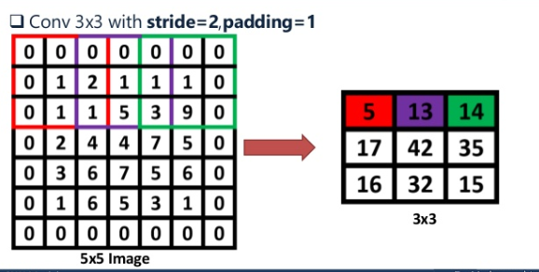
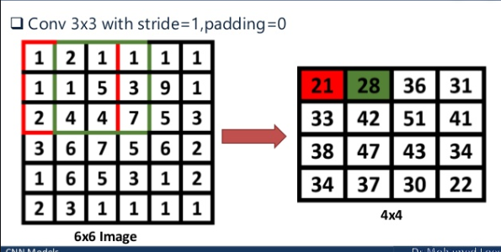
Effect of the stride.
We notice that increasing the stride decreases the processing time and the size but at the same time it might affect the accuracy of the output ( Tradeoff ).

Slide 36
Methodology:
How it works

Slide 37
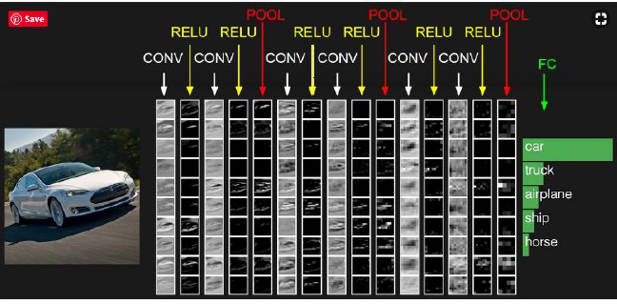

Slide 38
Methodology:
Comparative study

Slide 39
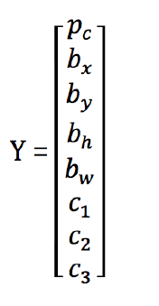
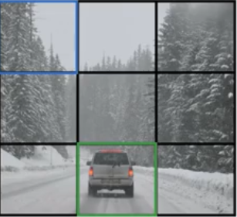
YOLO (You Only Look Once)
The idea is to divide the image into multiple grids.
Anchor boxes
IOU to determine center of object with threshold

Slide 40
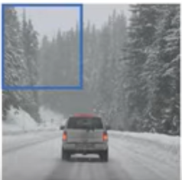
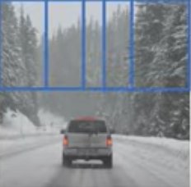
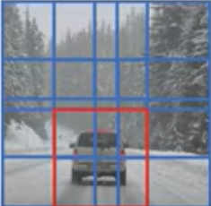
YOLO (You Only Look Once)
Sliding window implementation
One look
Share computation
Shortcomings
- Only look once much low accuracy - Small objects can't be detected - Suffers at generalizing the objects (if dimension changes it can't classify it )

Slide 41
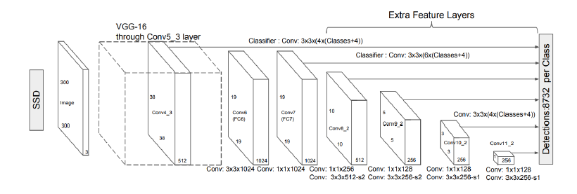
SSD (Single Shot Detector)
One shot and share many things with yolo
Many anchor boxes with different feature maps
6 aspect ratios allowed
Slower than yolo
- not suitable for real time application -

Slide 42
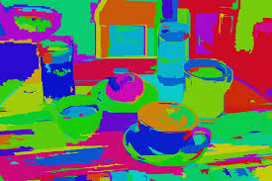
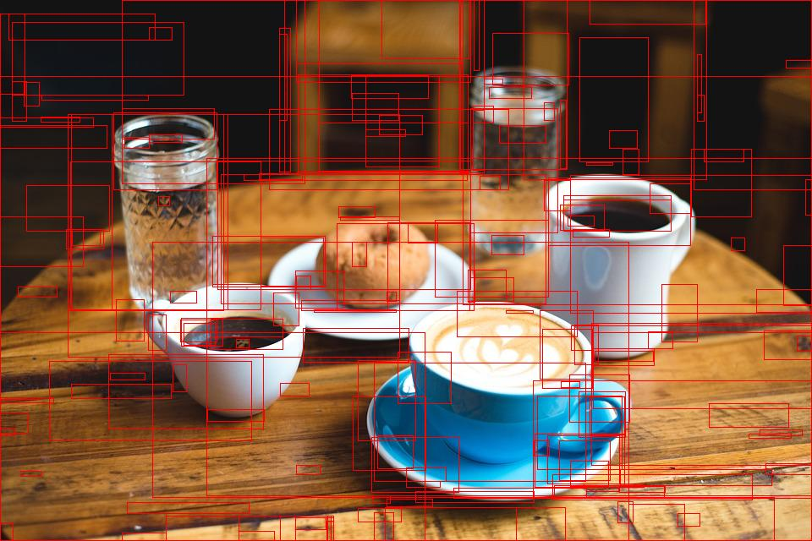
R-CNN.
RCNN uses selective search to extract these boxes from an image
Selective Search is a region proposal algorithm based on computing hierarchical grouping of similar regions based on color, texture, size and shape compatibility
After getting the regions, we train SVM to classify objects and background. For each class, we train one binary SVM

Slide 43
Problems with RCNN.
Extracting 2,000 regions for each image based on selective search.
Extracting features using CNN for every image region. Suppose we have N images, then the number of CNN features will be N*2,000
It takes around 40-50 seconds to make predictions for each new image, which essentially makes the model too slow.

Slide 44
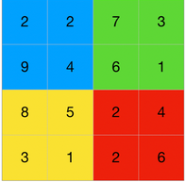
Fast RCNN.
In Fast RCNN, we feed the input image to the CNN, which in turn generates the convolutional feature maps. Using these maps, the regions of proposals are extracted.
The feature map is the output of one filter applied to the previous layer. A given filter is drawn across the entire previous layer, moved one pixel at a time.
A softmax layer is used on top of the fully connected network to output classes. Along with the softmax layer.
But still not the best.

Slide 45
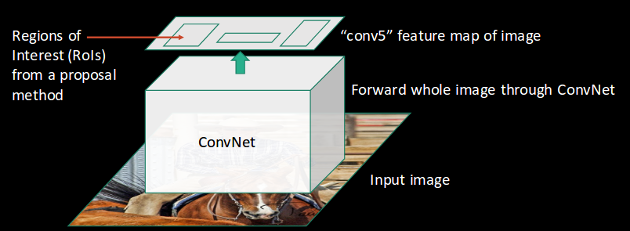

Slide 46
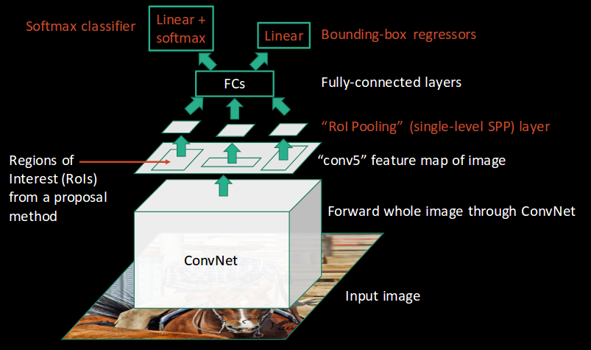

Slide 47
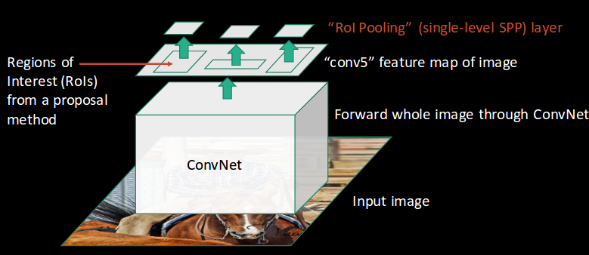

Slide 48
FASTER R-CNN
To begin with, Faster RCNN takes the feature maps from CNN and passes them on to the Region Proposal Network. RPN uses a sliding window over these feature maps, and at each window, it generates k Anchor boxes of different shapes and sizes:
Anchor boxes are fixed sized boundary boxes that are placed throughout the image and have different shapes and sizes. For each anchor, RPN predicts two things.
The first is the probability that an anchor is an object (it does not consider which class the object belongs to)
Second is the bounding box regressor for adjusting the anchors to better fit the object.

Slide 49
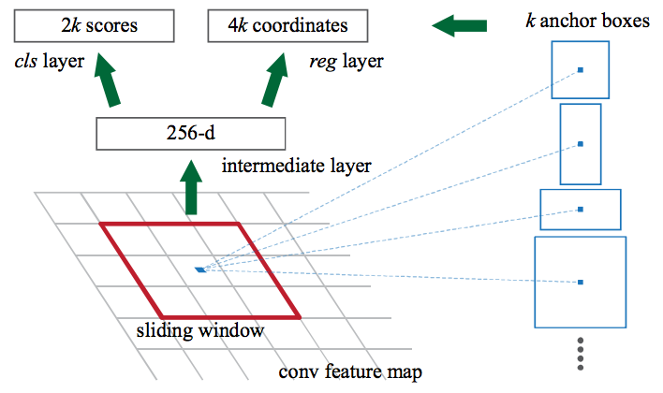
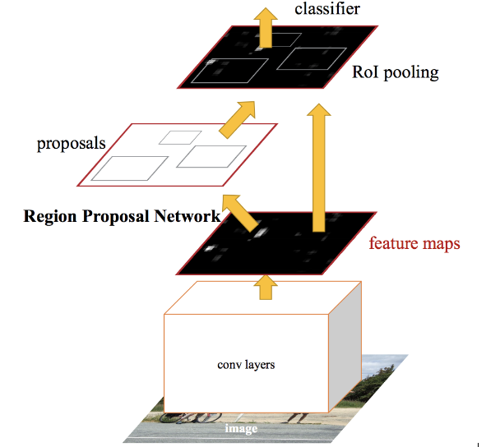

Slide 50
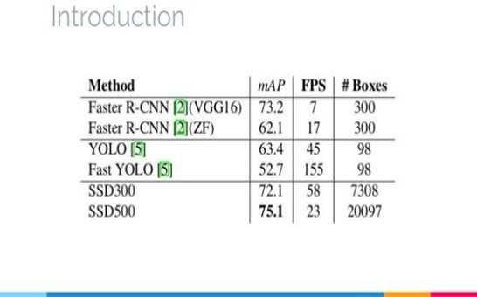
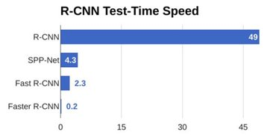
COMPARISON

Slide 51
Methodology:
Dataset

Slide 52
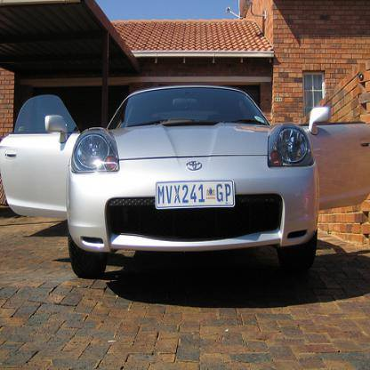
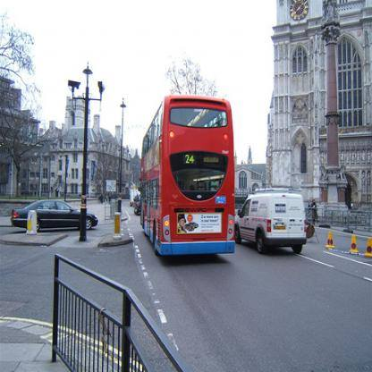
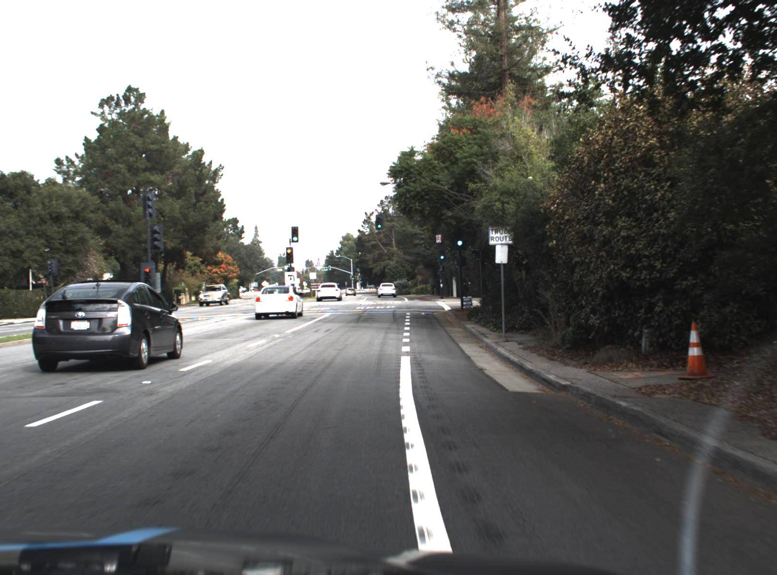
Faster-RCNN Simulation
Dataset used:
Udacity dataset
VOC dataset

Slide 53
Implementation

Slide 54
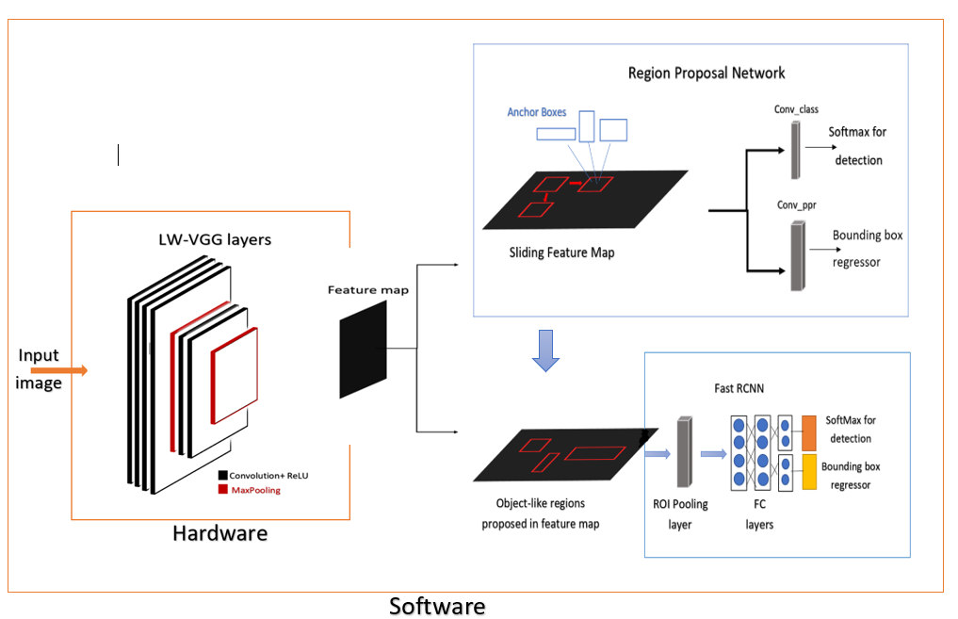
Block diagram of the project

Slide 55
Software

Slide 56
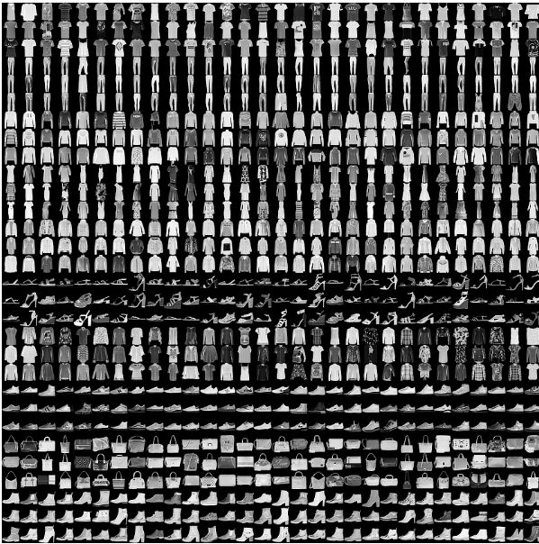
Software implementation
Objective:
Try to classify some fashion objects correctly using a neural network simulated by TensorFlow library
Used to test the concepts discussed in the literature

Slide 57
Layers used:
model = keras.Sequential([
keras.layers.Flatten(input_shape=(28, 28)), # flatten the input to be a list
# dense means a fully connected layer which is our hidden layer here relu is fast
keras.layers.Dense(128, "relu"),
keras.layers.Dense(64, "relu"),
keras.layers.Dropout(0.25),
# this is our output layer and each one of them represent what item is it ,softmax is used so that all the
# neurons in this layer add up to 1 making it a probability
keras.layers.Dense(10, "softmax")
])

Slide 58
Algorithms used
model.compile(optimizer="adam", loss="sparse_categorical_crossentropy", metrics=["accuracy"])
# this is used to train our network check what epochs is in the copybook
model.fit(train_images, train_labels, epochs=100)
# now its time to check how our network works so we will see the accuracy
test_loss, test_acc = model.evaluate(test_images, test_labels)
print("our accuracy is ", test_acc)

Slide 59
Results:
Layers | Accuracy after training | Accuracy of test data | Number of epochs | Simulation time/min | Dropout
1 Hidden layer of 128 neurons | 87% | 86% | 5 | 1.5 | 0
1 Hidden layer of 128 neurons | 90% | 88% | 10 | 3 | 0
1 Hidden layer of 128 neurons | 98% | 90% | 100 | 15 | 0.25
2 hidden layers of sizes 128 and 64 | 86% | 85% | 5 | 2 | 0
2 hidden layers of sizes 128 and 64 | 89% | 87% | 10 | 5 | 0
2 hidden layers of sizes 128 and 64 | 97% | 89.5% | 100 | 20 | 0.25

Slide 60
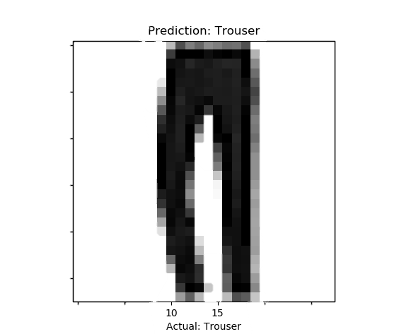
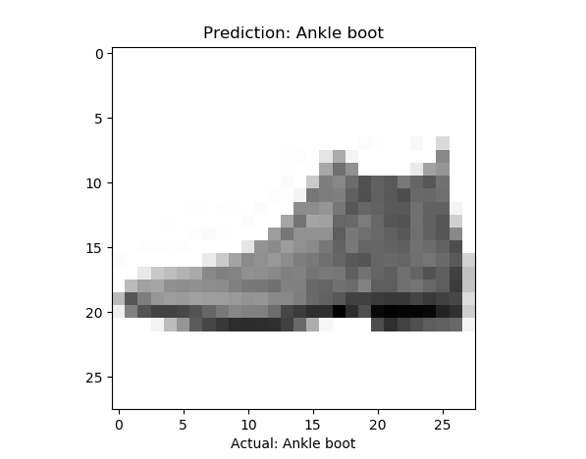
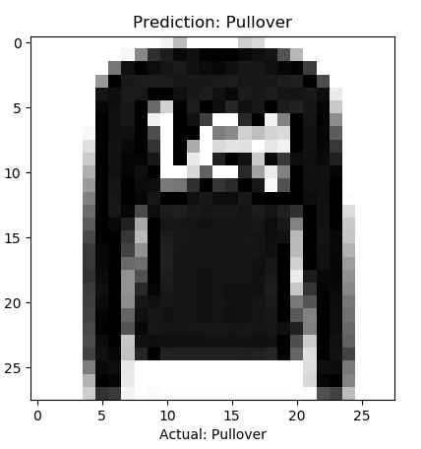
Results:

Slide 61
Faster-RCNN Simulation
Problems Faced During simulation:
Some libraries needs Linux operating system
Needs Large amounts of RAM for training
Very complex to code from scratch

Slide 62

Faster-RCNN Simulation
Solution to all of this is using Google Colabs for simulation

Slide 63
Faster-RCNN Simulation
Advantages of Google Colabs:
Fast simulation
Gives a lot of free RAM
Supports all the libraries needed in machine learning
Disadvantages of Google Colabs:
The output files are erased after the session ends
If there are input files needed for simulation, They need to be uploaded in every session

Slide 64

Faster-RCNN Simulation
Roboflow is online service to change annotation file formats to the ones you need for training.

Slide 65
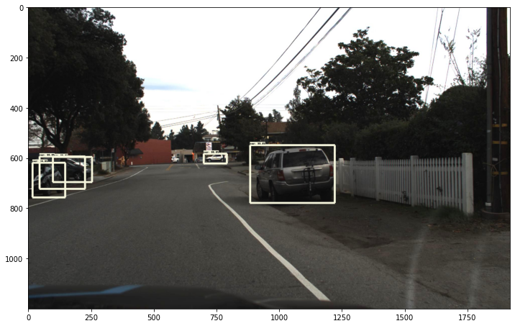
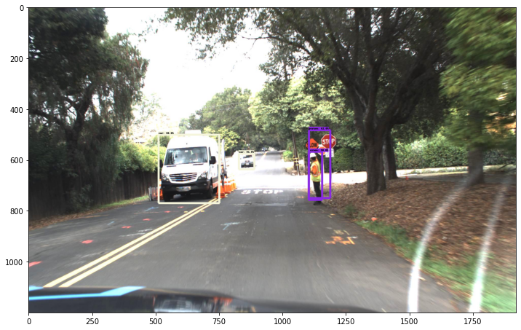
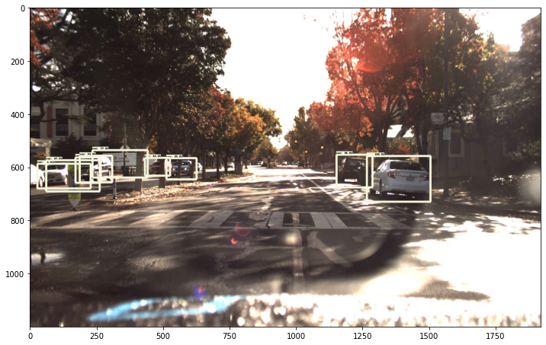

Results

Slide 66
Hardware Problems
RPN is very complex to be constructed in hardware
Limitations of memory
Needs large RAM to extract weights from the software part

Slide 67
Solution
We can construct the backbone network only in the hardware part and do a hardware/Software Co-Simulation

Slide 68
Design process
We checked the logic in the machine learning libraries in python
We write the same logic in C++ codes
We Use HLS tool to change the C++ codes to HDL codes Verilog/VHDL
PYTHON
C++
HDL
HLS

Slide 69
Extraction of weights
Backbone network of software design is vgg16, but it required nearly 46GB of RAM to extract the weights which was impossible to get even in google Colabs
So we had to design a light weight vgg16 to be compatible with the memory in hardware and we can extract weights from it with the available computational power
Layer (Type) | Output Shape | Param #
Convd2d | (None,28,28,64) | 640
Convd2d_1 | (None,28,28,64) | 36928
Max_pooling2d | (None,14,14,64) | 0
Convd2d_2 | (None,14,14,128) | 73856
Convd2d_3 | (None,14,14,128) | 147584
Max_pooling2d_1 | (None,7,7,128) | 0
Convd2d_4 | (None,7,7,256) | 295168
Convd2d_5 | (None,7,7,256) | 590080
Convd2d_6 | (None,7,7,256) | 590080
Max_pooling2d_2 | (None,4,4,256) | 0
Convd2d_7 | (None,4,4,512) | 1180160
Convd2d_8 | (None,4,4,512) | 2359808
Convd2d_9 | (None,4,4,512) | 2359808
Max_pooling2d_3 | (None,2,2,512) | 0
Convd2d_10 | (None,2,2,512) | 2359808
Convd2d_11 | (None,2,2,512) | 2359808
Convd2d_12 | (None,2,2,512) | 2359808
Max_pooling2d_4 | (None,1,1,512) | 0
Flatten | (None,512) | 0
Dense | (None,4096) | 2101248
Dense_1 | (None,4096) | 16781312
Dense_2 | (None,10) | 40970

Slide 70

LW VGG16

Slide 71
Extraction of weights
A python script was developed to extract the weights as the normal extensions for the extracted weights in python is h5 or pb are not readable so can’t be used in hardware
Text File
✓
Script
LWVGG16
H5/Pb File

Slide 72
Changing images to readable form
Another Python script was developed to change the input images to matrix form so it can be readable in C++
Images
Software
Hardware
Images
Weights

Slide 73
Hardware

Slide 74
Methods of design
RTL
High level
Synthesis
(HLS)

Slide 75

HLS different tools
Vivado HLS by Xilinx
Catapult by Mentor
HDL coder by MathWorks
Intel High level synthesis compiler by Intel
We use :
Vivado HLS ® 2019.2

Slide 76

What is HLS anyway ?

Slide 77
Advantages of HLS
Designing at a higher level of abstraction = increase productivity
Debugging software is much faster than hardware
Easier to specify functions in software
Simulation of RTL takes thousands times longer than software

Slide 78

Hardware Implementation
Block diagram of layers of VGG-16
Figure 5

Slide 79
Hardware:
Convolution layer

Slide 80
Convolution Layer
Inputs: Taking the input RGB image as three-dimensional array with (channel * row * column ) and the kernels number , channels and size as four-dimension array (kernel number, kernel channel, row, column)
Outputs: The feature maps the number of them is equal to the number of filters and the size is equal to image size –kernel size +1 if no padding is used

Slide 81
Software Results_v1
Input
11 | 21 | 17 | 5 | 13
17 | 12 | 5 | 12 | 4
9 | 15 | 37 | 8 | 20
39 | 19 | 14 | 10 | 18
26 | 38 | 47 | 31 | 7
Kernel
44 | 26 | 2
33 | 39 | 46
41 | 1 | 35
Figure 15
Conv-op
4615 | 7527 | 8074
4443 | 4960 | 7363
6547 | 7192 | 5629

Slide 82
Simulation results
The simulation shows that convolution process is carried out as intend in the c++ code and below output is output of c++ testbench and the output exactly the same. Noting that the we0 (write signal in the output memory (array)is high only when the correct result signals has arrived can be specified by the clock period during project )

Slide 83


Slide 84

Simulation results (RGB Input images and kernel channels)

Slide 85
Hardware:
Padding Layer

Slide 86
Padding Layer
Inputs: Input matrix of size NxM
Outputs: Output matrix of size N+2*pad x M+2*pad of the NxM matrix surrounded by zeros

Slide 87

Simulation results

Slide 88

When the input is 3d Matrix (channels * columns*rows)

Slide 89

Padding ( padding image with multiple channels )

Slide 90
Hardware:
Max pooling Layer

Slide 91
Max Pooling Layer
Inputs: Input matrix of NxM
Outputs: Output matrix of N/2 x M/2 but with the maximum numbers only of the input

Slide 92

Software Results
Input channel 1
44 | 98 | 69 | 77 | 9 | 51
79 | 60 | 47 | 39 | 70 | 74
99 | 81 | 3 | 54 | 67 | 28
2 | 38 | 72 | 46 | 91 | 45
41 | 23 | 8 | 74 | 18 | 79
23 | 92 | 96 | 62 | 14 | 62
Input channel 3
78 | 16 | 22 | 76 | 34 | 21
73 | 38 | 18 | 50 | 19 | 22
84 | 46 | 39 | 23 | 6 | 41
8 | 38 | 44 | 5 | 66 | 75
0 | 19 | 58 | 38 | 56 | 19
55 | 38 | 49 | 97 | 18 | 8
Input channel 2
75 | 50 | 60 | 57 | 14 | 22
5 | 78 | 18 | 9 | 30 | 78
77 | 29 | 54 | 78 | 52 | 77
92 | 43 | 23 | 89 | 91 | 70
32 | 52 | 54 | 81 | 11 | 14
87 | 9 | 48 | 95 | 55 | 0

Slide 93
Output channel 1
98 | 77 | 74
99 | 72 | 91
92 | 96 | 79
Output channel 2
75 | 60 | 78
92 | 89 | 91
87 | 95 | 55
Output channel 3
78 | 76 | 34
84 | 44 | 75
55 | 97 | 56

Slide 94

Simulation Results

Slide 95
Hardware:
ReLU

Slide 96
ReLU Layer
Inputs: Input matrix of defined size
Outputs: Output matrix of same defined size but output greater than zero only

Slide 97

Simulation Results

Slide 98
Hardware:
Fully-connected layer

Slide 99
Fully-Connected Layer
Inputs: Flattened input 1 dimensional
Outputs: The flattened input multiplied by the weights then adding the bias on them

Slide 100
Software Results
Input
1 | 2 | 3 | 4 | 5 | 6 | 7 | 8
Weights (2D array) | 1 | 1
 | 2 | 2
 | 3 | 3
 | 4 | 4
 | 5 | 5
 | 6 | 6
 | 7 | 7
 | 8 | 8
Fully-Connected
Layer
Output
37 | 74 | 111 | 148 | 185 | 222 | 259 | 296
Bias
1 | 2 | 3 | 4 | 5 | 6 | 7 | 8

Slide 101
Performance evaluation
 | Latency(cycles) |  | Latency(absolute)
 | min | max | min | min
Convolution | 869 | 869 | 8.690 us | 8.690 us
padding | 79 | 79 | 0.790 us | 0.790 us
Max pooling | 206 | 206 | 206 | 206
ReLU | 0 | 0 | 0 | 0

Slide 102
Performance evaluation
 | Total |  |  |  |  | Utilization(%)
 | BRAM_18K | DSP48E | FF | LUT | URAM | BRAM_18K | DSP48E | FF | LUT | URAM
Convolution | 0 | 3 | 476 | 757 | 0 | 0 | 0 | 0 | 0 | 0
Padding | 0 | 0 | 59 | 277 | 0 | 0 | 0 | 0 | 0 | 0
Max pooling | 0 | 0 | 471 | 1541 | 0 | 0 | 0 | 0 | 0 | 0
ReLU | 0 | 0 | 0 | 49 | 0 | 0 | 0 | 0 | 0 | 0
Integration of padding& convolution& max pooling | 1 | 3 | 944 | 2186 | 0 | 0 | 0 | 0 | 0 | 0

Slide 103
Future work

Slide 104
Future work
Run Co-Simulation between the hardware and software part
Download the code on FPGA
Construct the whole Faster-RCNN in hardware

Slide 105
Thank You

